Slide 1
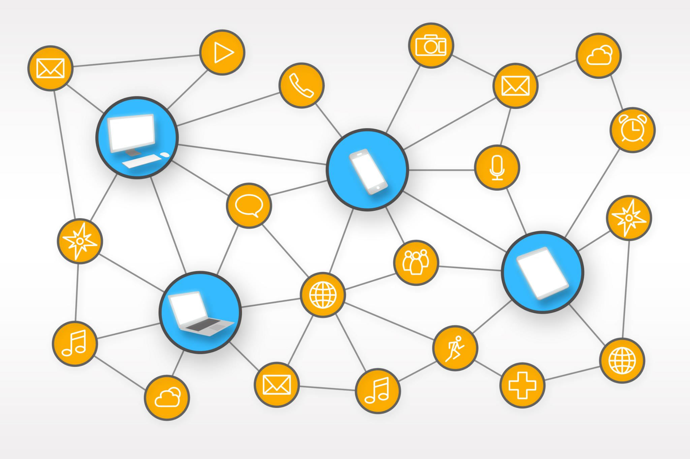
Managing Risk in Supply Chains: Frameworks, Strategies & Case Studies
Approaches to identify and mitigate supply chain risks
Notes:
---

Slide 2
Introduction to Supply Chain Risk
Notes:
Understanding Supply Chain Risk and Its Impact

Slide 3
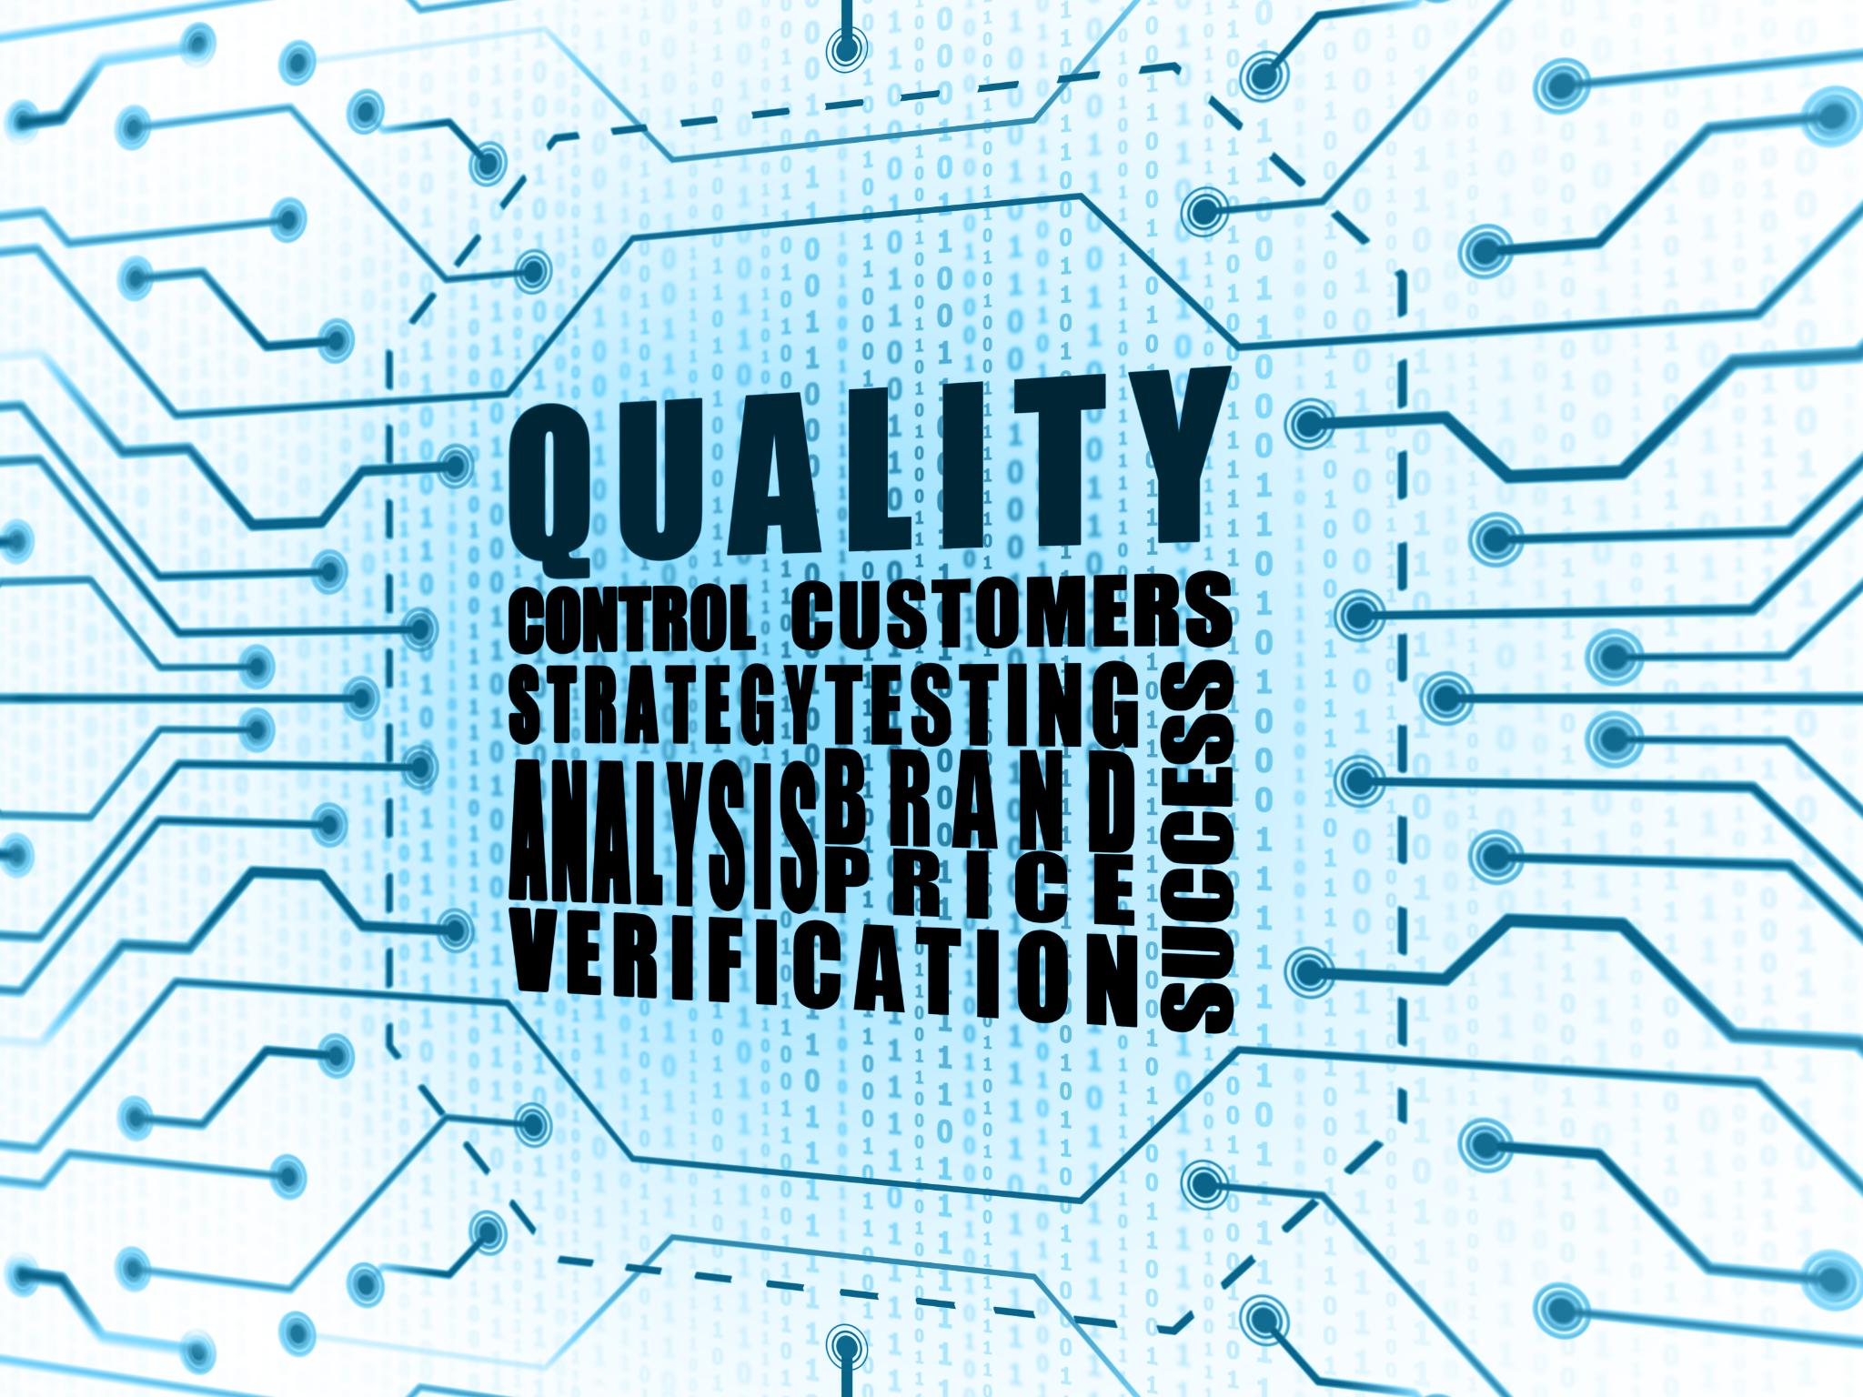
Understanding Supply Chain Risk and Its Impact
Definition of Supply Chain Risk
  Supply chain risk involves potential disruptions affecting goods, services, and information flow across networks.
Impact of Low-Probability High-Impact Events
  Rare but severe events like natural disasters can cause catastrophic operational and financial damage.
  Operational Resilience and Risk Management
  Building resilience requires vulnerability identification, scenario planning, and contingency strategies.
  Strategic Risk Mitigation Decisions
  Strategic choices like supplier consolidation and production relocation influence overall risk exposure.
Notes:
Supply chain risk refers to the potential for disruptions that can negatively impact the flow of goods, services, and information across the network. It is commonly expressed as Risk = Probability of Disruption × Impact. While many organizations focus on IT or internal processes, the most significant vulnerabilities often lie in the extended supply chain. Low-probability but high-impact events, such as natural disasters or factory shutdowns, can have catastrophic consequences. For example, a tornado in Jackson, Tennessee in 2003 severely damaged Procter & Gamble’s sole North American Pringles factory, curtailing production of a $1 billion revenue product. The goal of risk management is to build operational resilience, enabling rapid recovery and continuity of service levels. Resilience requires proactive identification of vulnerabilities, scenario modeling, and contingency planning. Companies must recognize that strategic decisions, such as relocating production or consolidating suppliers, directly affect risk exposure. By integrating risk considerations into sourcing and design decisions, firms can mitigate disruptions and protect earnings streams.

Slide 4
Sources of Risk in Supply Chains
Notes:
Five Key Sources of Risk

Slide 5
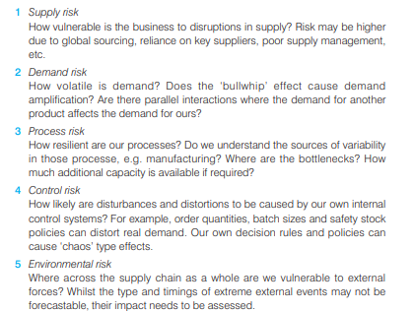
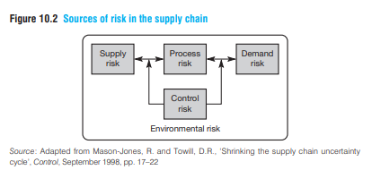
Understanding the supply chain risk profile
Supply chain risk = Probability of disruption × Impact

Slide 6
Five Key Sources of Risk
Risk Source | Description | Example
Supply Risk | Dependence on key suppliers, global sourcing | Single-source component from overseas
Demand Risk | Volatility, bullwhip effect | Sudden surge in seasonal product demand
Process Risk | Bottlenecks, variability | Limited capacity in critical assembly line
Control Risk | Distortions from internal policies | Batch ordering inflates perceived demand
Environmental Risk | External shocks | Earthquake disrupting transport routes
Notes:
Supply chain vulnerabilities arise from five interconnected sources: Supply Risk, Demand Risk, Process Risk, Control Risk, and Environmental Risk. Supply Risk includes dependence on single suppliers, global sourcing complexities, and poor supplier management. Demand Risk stems from volatility, demand amplification through the bullwhip effect, and parallel product interactions. Process Risk relates to internal bottlenecks, variability in manufacturing, and limited capacity. Control Risk occurs when internal policies distort demand signals, such as batching or safety stock rules, creating chaos effects. Environmental Risk encompasses external shocks like geopolitical instability, natural disasters, and regulatory changes. These risks often interact, amplifying disruptions. For instance, a single-source supplier located in a flood-prone region represents both supply and environmental risk. Mapping these sources helps firms audit vulnerabilities and prioritize mitigation strategies. A structured risk profile ensures management attention is focused on critical paths where failure would severely impact performance.

Slide 7
Risk Assessment and Numerical Examples
Notes:
Developing a Risk Profile and Using FMEA

Slide 8
Developing a Risk Profile and Using FMEA
Example | Calculation | Result
Risk Exposure | Probability 0.2 × Impact $5M | $1M
FMEA Case 1 | S=4, O=3, D=4 | RPN=48
FMEA Case 2 | S=5, O=2, D=5 | RPN=50
Safety Stock Impact | Lead time ↑ from 10 to 25 days; σ=200/day | +3,000 units
Notes:
Creating a risk profile involves six steps: prioritizing earnings drivers, identifying critical infrastructure, locating vulnerabilities, modeling scenarios, developing responses, and monitoring the risk environment. Earnings drivers such as manufacturing or logistics must be mapped to understand their impact on profitability. Vulnerabilities often include bottlenecks, high concentration of suppliers, and limited alternatives. Scenario modeling, such as using a 'Wheel of Crises,' helps anticipate diverse disruptions. Failure Mode and Effect Analysis (FMEA) is a systematic tool for identifying critical nodes and links. It evaluates severity (S), occurrence (O), and detectability (D) to calculate a Risk Priority Number (RPN = S × O × D). For example, if S=4, O=3, D=4, RPN=48 (medium-high risk). Another case: S=5, O=2, D=5 yields RPN=50 (high risk). Numerical risk exposure can also be calculated: if probability=0.2 and impact=$5M, expected exposure=$1M. These metrics guide prioritization and resource allocation for mitigation strategies.

Slide 9
Risk Mitigation Strategies
Notes:
Redundancy vs Flexibility

Slide 10

Redundancy vs Flexibility
Redundancy Buffers
  Redundancy creates buffers like excess inventory and backup systems to mitigate risk but may increase costs and reduce competitiveness.
Flexibility Advantages
  Flexibility improves agility and responsiveness through adaptable product design, lead-time reduction, and cross-trained employees.
Technology and Planning Tools
  Dynamic inventory planning and supply chain visibility tools like RFID and SCEM enhance resilience and risk response.
Cost-Benefit Evaluation
  Companies must evaluate trade-offs using modeling tools to align risk strategies with risk magnitude and likelihood.
Notes:
Risk mitigation strategies fall into two categories: redundancy and flexibility. Redundancy involves creating buffers such as excess inventory, backup IT systems, and long-term supplier contracts. While effective, these measures often carry high explicit and hidden costs, potentially reducing competitiveness. Flexibility, on the other hand, enhances agility and responsiveness without excessive cost. Examples include product design for agility through common components and delayed differentiation, transferable manufacturing practices, and lead-time reduction. Dynamic inventory planning and supply chain visibility tools like RFID and Supply Chain Event Management (SCEM) further strengthen resilience. Cross-training employees ensures operational continuity during disruptions. Flexible strategies not only mitigate risk but also improve competitive capability by enabling rapid adaptation to changing conditions. Companies should evaluate the cost-benefit trade-offs of redundancy versus flexibility using modeling tools to ensure proportional responses aligned with risk magnitude and likelihood.

Slide 11
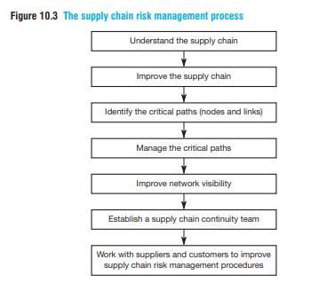
Seven-Stage Risk Management Process
Notes:
Framework for Managing Supply Chain Risk

Slide 12
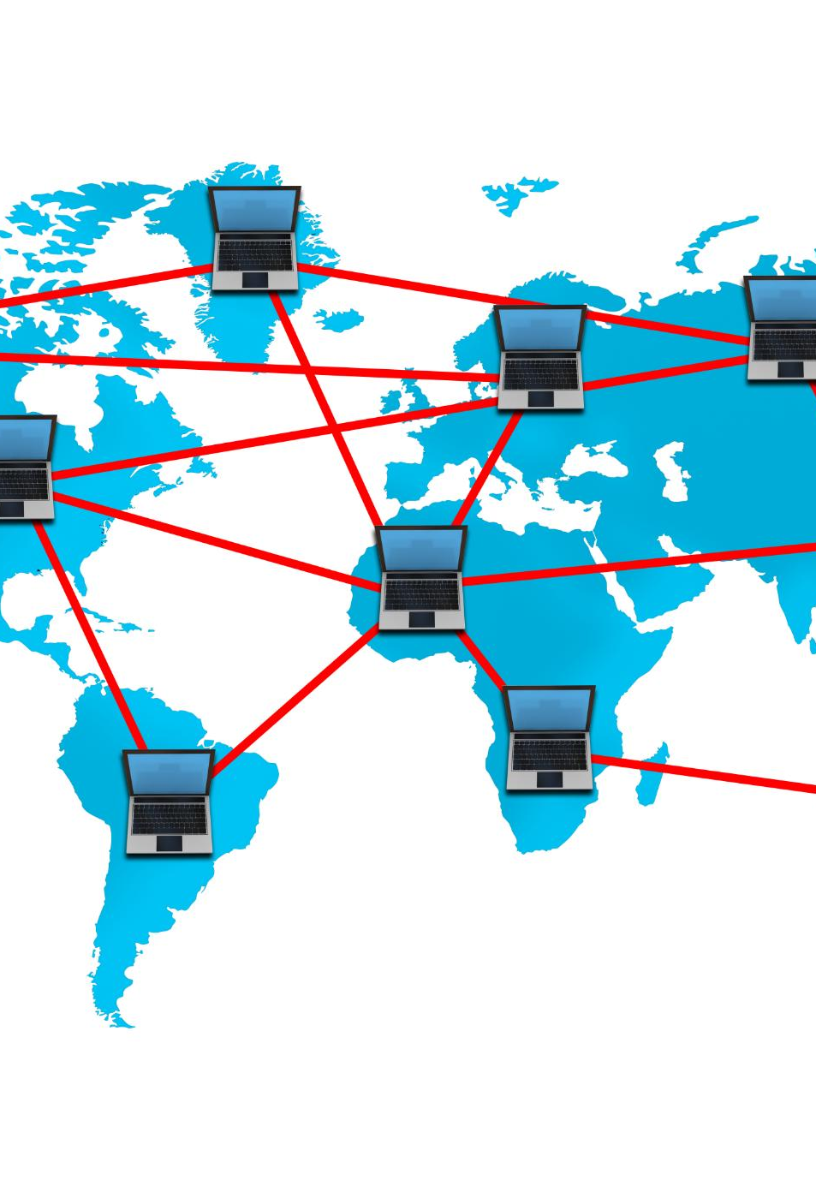
Framework for Managing Supply Chain Risk
Supply Chain Mapping
  Understand supply chain tiers beyond Tier-1 suppliers by thorough mapping of upstream and downstream partners.
Reducing Complexity
  Use Six Sigma and DMAIC methodologies to reduce variability and complexity in supply chain operations.
Critical Path Identification
  Identify critical nodes and links in the supply chain using Failure Mode and Effects Analysis (FMEA) to assess risk impact.
Enhancing Network Visibility
  Improve supply chain visibility through technologies like RFID, satellite tracking, and supply chain event management.
Notes:
The seven-stage process for managing supply chain risk includes: 1) Understand the supply chain by mapping upstream and downstream tiers beyond Tier-1 suppliers; 2) Improve the supply chain by reducing complexity and variability using Six Sigma and DMAIC methodologies; 3) Identify critical paths—nodes and links whose failure would severely impact performance—using tools like FMEA; 4) Manage critical paths through contingency planning, capacity adjustments, and strategic inventory; 5) Improve network visibility using RFID, SCEM, and satellite tracking to detect disruptions early; 6) Establish a supply chain continuity team with cross-functional expertise and a risk register; 7) Collaborate with suppliers and customers to align processes and share risk management practices. This iterative cycle fosters resilience and ensures that risk considerations are integrated into strategic decisions, such as sourcing and facility location.

Slide 13
Building Supply Chain Resilience
Notes:
Key Elements of Resilience

Slide 14

Key Elements of Resilience
Agility and Flexibility
  Supply chains must be agile and flexible, using slack at bottlenecks to quickly ramp operations up or down during disruptions.
Visibility and Technology
  Technologies like RFID and satellite tracking provide transparency and early access to information for proactive supply chain responses.
Collaborative Intelligence
  Collaboration with suppliers and customers builds trust and shared responsibility across the network for resilience.
Governance and Risk Management
  Board oversight, risk registers, and strategic thinking embed resilience into organizational culture and decision-making.
Notes:
Supply chain resilience is the ability to return to a desired state after disruption. It requires agility, visibility, and acceleration—the capacity to ramp up or down quickly. Slack at critical points, such as bottlenecks, ensures flexibility during shocks. Early access to information and collaborative intelligence across the network are essential for proactive responses. Technologies like RFID and satellite tracking enhance transparency, while collaborative planning with suppliers and customers builds trust and shared responsibility. Governance plays a vital role: board-level oversight, risk registers, and real options thinking embed resilience into organizational culture. Resilient supply chains balance efficiency with redundancy, ensuring that strategic decisions—such as relocating facilities or consolidating suppliers—are evaluated for their impact on risk profiles. By integrating resilience principles into design and operations, firms can maintain continuity and competitive advantage even in volatile environments.

Slide 15
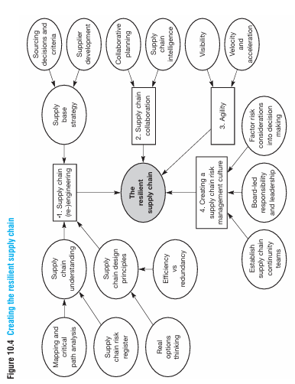

Slide 16
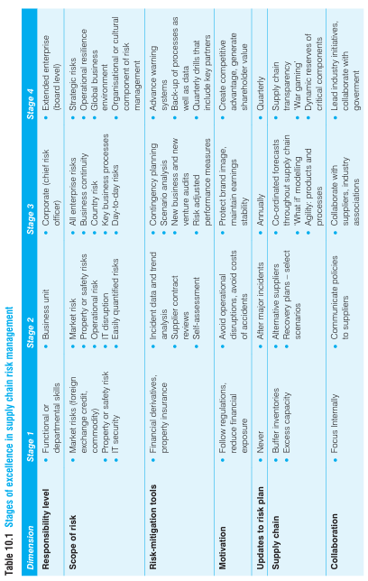

Slide 17
Case Studies and Lessons Learned
Notes:
Mattel, Toyota, and Nokia vs Ericsson

Slide 18

Mattel, Toyota, and Nokia vs Ericsson
Mattel Recall Incident
  Mattel’s $110 million recall in 2007 exposed risks from second-tier suppliers and the need for deeper supplier visibility.
Toyota Global Recalls
  Toyota’s 2009–2010 recalls revealed risks from supplier over-reliance and highlighted balancing lean manufacturing with risk control.
Nokia and Ericsson Disruptions
  Nokia’s swift event management enabled rapid recovery from a semiconductor factory fire, unlike Ericsson’s delayed response causing major losses.
Lessons on Risk Management
  Proactive risk mapping, collaboration, and visibility tools are critical for building resilient supply chains and avoiding costly disruptions.
Notes:
Real-world cases illustrate the consequences of inadequate risk management. Mattel faced a $110 million recall in 2007 due to lead paint contamination originating from a second-tier supplier, highlighting the need for deeper tier visibility. Toyota’s 2009–2010 global recalls, caused by throttle pedal defects, revealed vulnerabilities from over-reliance on tiered suppliers and underscored the importance of balancing lean practices with risk control. Nokia and Ericsson both experienced supply disruptions in 2000 when a semiconductor factory fire halted production. Nokia’s superior event management and visibility enabled rapid recovery through alternative sourcing, while Ericsson’s delayed response led to significant revenue loss and eventual exit from mobile phone manufacturing. These cases emphasize proactive risk mapping, collaborative relationships, and investment in visibility tools as critical enablers of resilience.

Slide 19
Conclusion and Actionable Steps
Notes:
Key Takeaways for Implementation

Slide 20

Key Takeaways for Implementation
Cross-functional Teams & Risk Register
  Establish diverse continuity teams and maintain an active risk register to manage supply chain risks effectively.
Scenario Drills & Monitoring
  Conduct quarterly scenario drills with partners and instrument critical paths with monitoring tools for better preparedness.
Integrated Risk in Decisions
  Incorporate risk considerations into sourcing and design decisions to reduce vulnerabilities early in the process.
Collaborative Planning & Technology
  Collaborate with suppliers and customers using technology for visibility and agility to respond swiftly to disruptions.
Notes:
To effectively manage supply chain risk, organizations should establish cross-functional continuity teams and maintain a dynamic risk register. Quarterly scenario drills involving key partners enhance preparedness. Critical paths must be instrumented with monitoring tools, and FMEA should be applied to nodes and links to prioritize mitigation efforts. Risk considerations should be integrated into sourcing and design decisions to prevent vulnerabilities from escalating. Collaborative planning with suppliers and customers fosters shared responsibility and transparency. Finally, leveraging technology for visibility and agility ensures that firms can respond swiftly to disruptions, safeguarding earnings and reputation. By embedding resilience into strategy and operations, companies can transform risk management from a defensive posture into a source of competitive advantage.

